Slide 1
Toward the Agentic Web - W3C’s Work on AI Agent Protocols and Beyond
Ruoxi(Roy) Ran
W3C
ran@w3.org

Slide 2
Semantic Web & Agentic Web
The Semantic Web
The Agentic Web
Proposed by Tim Berners-Lee over 20 years ago
Aimed to create a machine-readable web of data
Envisioned "intelligent agents" to autonomously navigate
W3C developed technologies like XML, RDF, and ontology
Enabled by powerful Large Language Models (LLMs)
Agents as primary actors, interacting with network
Ecosystem of autonomous, intelligent, collaborative agents
Shift from human-centered to agent-centered collaboration
“ The Agentic Web inherits the core vision of the Semantic Web.

Slide 3
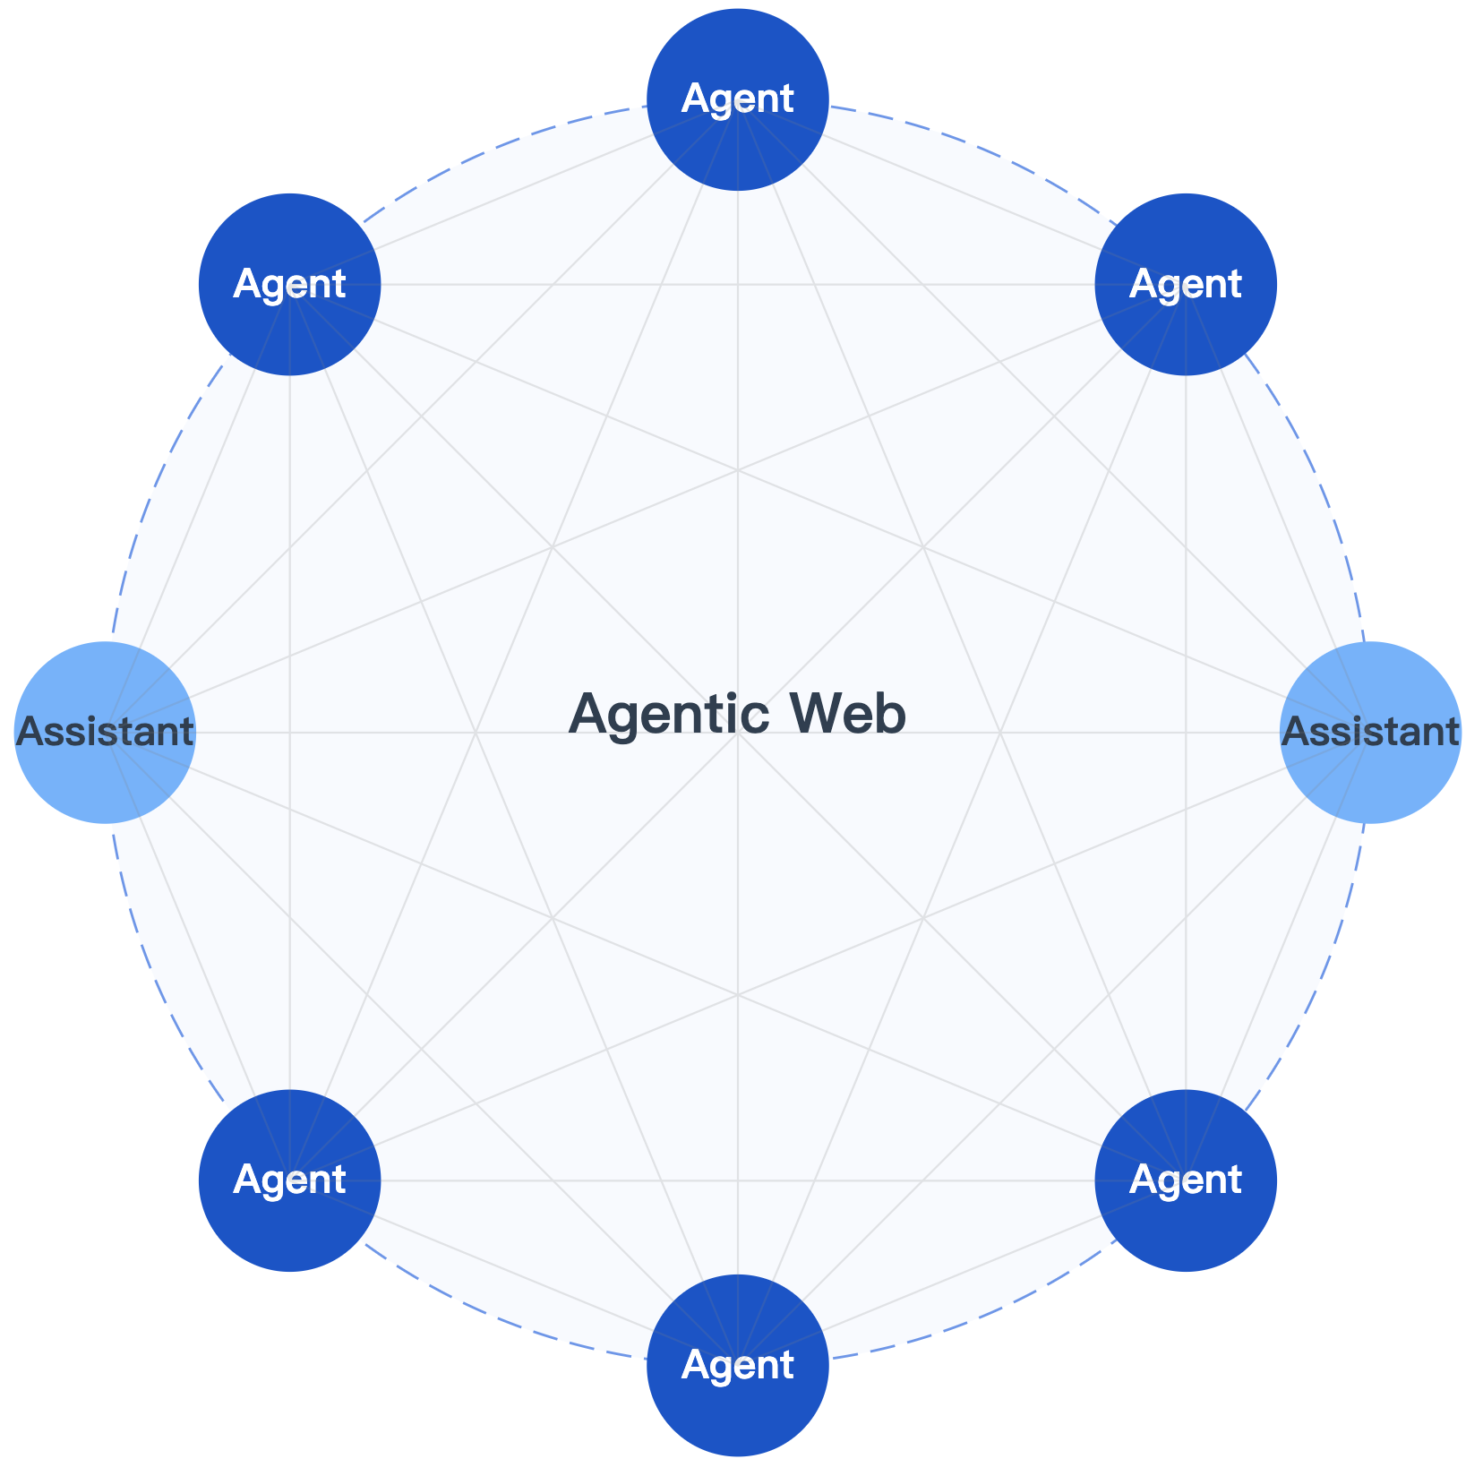
The Agentic Web Concept
Deﬁnition
The Agentic Web is a new paradigm where agents are the primary actors on the internet, actively interacting with network resources and services to accomplish user goals.
Related work in W3C
AI Agent protocol
Multi-agent-system (MAS)
Data(RDF, JSON-LD etc,.)
APIs(WebNN, WASM, Prompt API etc,.)
Impact on Web(Ethical, Security, Privacy etc,.)
...

Slide 4
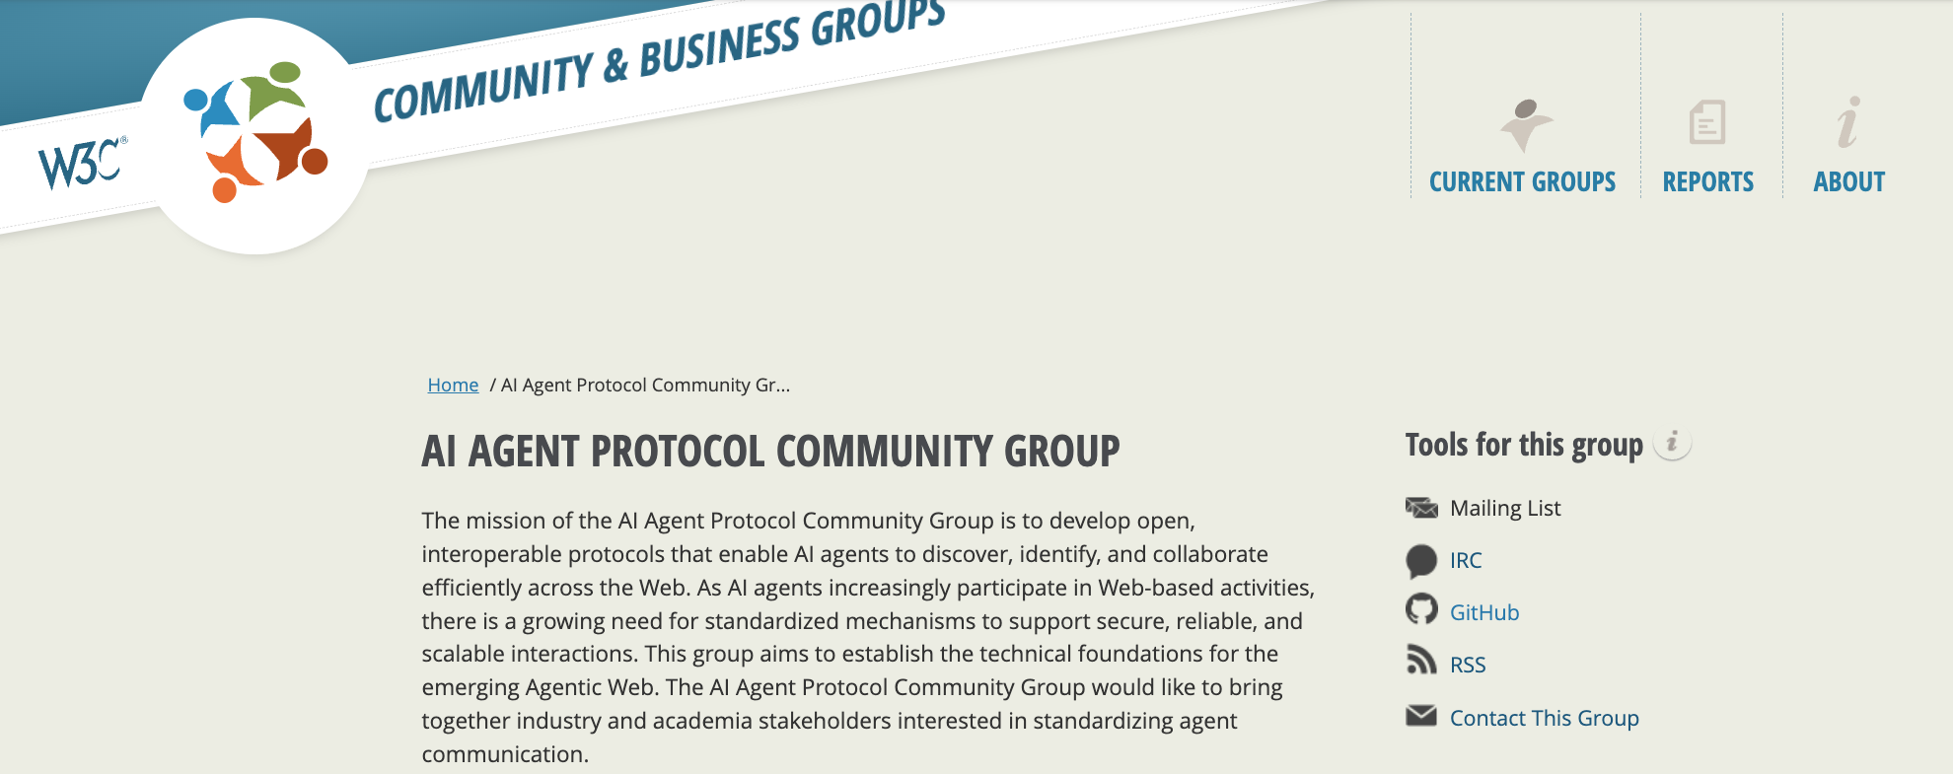
AI agent protocol CG
W3C AI Agent Protocol Community Group
Homepage: https://www.w3.org/community/agentprotocol/
Whiter Paper: https://w3c-cg.github.io/ai-agent-protocol/
Use Cases: https://w3c-cg.github.io/ai-agent-protocol/use_case.html
Protocol Specification: https://w3c-cg.github.io/ai-agent-protocol/protocol.html

Slide 5
AI Agent Protocols
Within this ecosystem, there are several approaches:
Model Context Protocol
Agent-to-Agent Protocol
Agent Network Protocol
Initiated by Anthropic
"USB-C port for AI"
Solves M×N integration problem
Contributed to Linux Foundation by Google
Focuses on cross-vendor interoperability
Supports task collaboration and negotiation
Open-source community effort
"HTTP of the Agentic Web"
Use JSON-LD and DID
Agent Connect Protocol
Agent Communication Protocol
Agent Communication Network
initiative by Cisco
Communication layer for autonomous
Uses RESTful APIs and message passing
Contributed to Linux Foundation by IBM
Shared language for heterogeneous agents
Emphasizes peer-to-peer model
Initiated from Telecommunication industry
Telecom Operators
Comm. Core Networking + Trusted Identity
...
For more information, see:
https://w3c-cg.github.io/ai-agent-protocol/#protocol-overview
or: https://w3c-cg.github.io/webagents/TaskForces/Interoperability/Reports/report-interoperability.html#state-of-web-based-multi-agent-systems
“

Slide 6
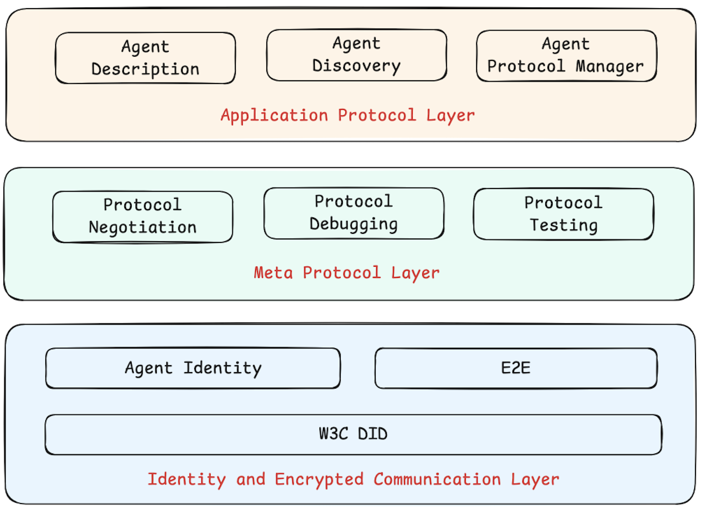
AI agent protocol CG
Inter-agent communication
Identity and Trust
Security and privacy mechanisms
Based on W3C Standards, but open to others
Compatibility
For more information, see Protocol Specification at:
https://w3c-cg.github.io/ai-agent-protocol/protocol.html
“

Slide 7
AI agent protocol
some key technical elements in discussion:
Agent Identity
Agent Description
Agent Discovery
Security/Privacy
Uniﬁed identity verification across platforms
Enables trusted interactions between agents
DID / OpenID / API Keys?
Basic information description
Capability, supported protocols declaration
JSON / JSON-LD / WoT-TD?
Dynamic searching
semantic matching, task requirements, or capability characteristics
Well-known URIs / Directories?
Authentication and Authorization
Communication Encryption
Data Integrity Protection
For more information, see Protocol Specification at:
https://w3c-cg.github.io/ai-agent-protocol/protocol.html
“

Slide 8
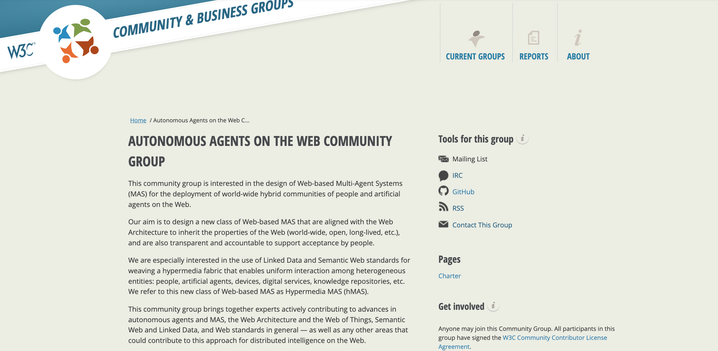
Autonomous Agents on the Web CG
W3C Autonomous Agents on the Web Community Group
Homepage: https://www.w3.org/community/webagents/
Interoperability for Agents on the Web: https://w3c-cg.github.io/webagents/TaskForces/Interoperability/Reports/report-interoperability.html
Manageable Affordances: https://w3c-cg.github.io/webagents/TaskForces/ManageableAffordance/Reports/report-ma-gap-analysis.html

Slide 9
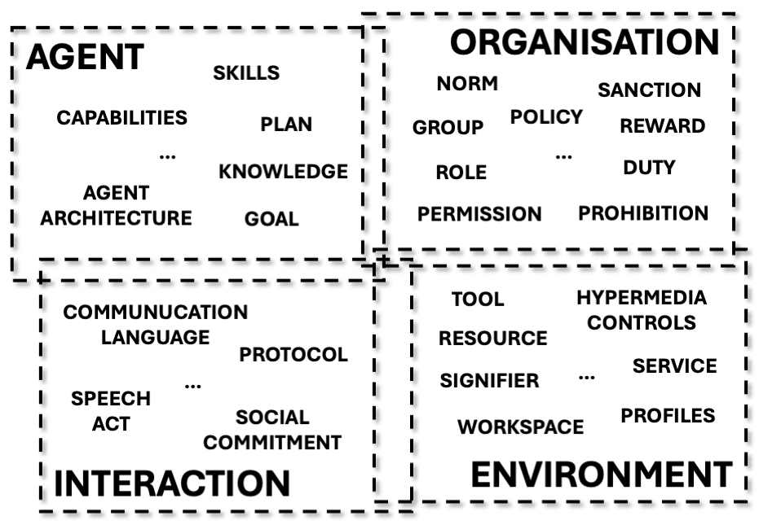
Multi-Agent System (MAS) on Web
Follow the four modelling dimensions used in research on engineering MAS: agent, environment, interaction, and organization.
Modelling Dimensions for Engineering Multi-Agent Systems [Demazeu, 1995]
For more information, see Interoperability at:
https://w3c-cg.github.io/webagents/TaskForces/Interoperability/Reports/report-interoperability.html
“

Slide 10
Other AI Agents Works in W3C
AI agent work also connects to broader W3C activities:
Data
Security/Privacy
AI methods APIs
RDF & SPARQL
JSON-LD
Linked Web Storage
AI in the Browser
Privacy Principles
Threat modeling CG
Linked Web Storage
Prompt API
Proofreader API
Writing Assistance APIs
Translator/Language Detector API
AI Agent within Webapp
Ethical
Impact on Web
WebGPU
WebNN
WebAssembly
...
AI & the Web: Understanding and managing the impact of Machine Learning models on the Web
Draft report on AI agents
Ethical Principles for Web Machine Learning
Web User Agents

Slide 11
Ongoing explorations in W3C
Workshop: "AI Agents & the Web" (tentative)
AI Agents in the Web Ecosystem
Inter-Agent Communication Across the Open Web
Emerging Use Cases and Requirements for AI Agents
Standardization Gaps and Opportunities
Feedback welcome: https://github.com/w3c/strategy/issues/507
Web & AI Interest Group （In preparation）
Serve as a focal point to receive updates from AI-relevant groups
Integrate AI-related technologies
Publish AI-related IG reports
Feedback welcome: https://github.com/w3c/strategy/issues/511

Slide 12
Thank you!

